Slide 1
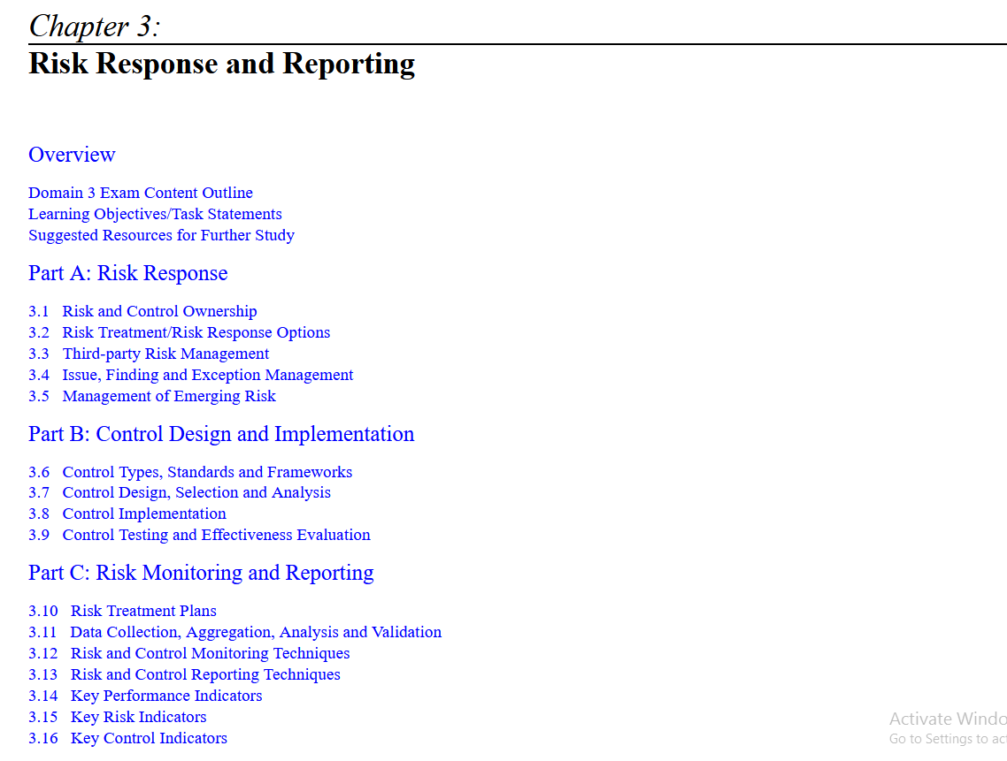

Slide 2
Overview
  By identifying and analyzing risk, enterprises become aware of what forces within and beyond their control might threaten their operations.
  However, documenting the results of this analysis in a risk register only provides awareness of the situation as it exists.
  From there, the next steps are for the enterprise to decide how to respond to the analyzed risk, which may include the design and implementation of new controls or enhancements to existing controls; and then conduct effective monitoring and reporting of risk to keep management informed in a timely manner.
  This chapter represents 32 percent (approximately 48 questions) of the exam.

Slide 3
Part A: Risk Response
  The risk response phase of risk management, shown in figure 3.1, focuses on the decisions made regarding the correct way to address identified risk, Risk response is based on the information provided in the earlier steps of risk identification and risk assessment.
  The desire to reduce risk is balanced with the constraints placed on the enterprise through budget, time, resources, strategic plans, regulations, customer expectations and other business and industry factors.
  Risk response should be undertaken in a way that protects current operations to the greatest extent possible.
  In some cases, response activities may cause disruption. this makes the careful selection of actions and controls to address risk an important part of the process.

Slide 4
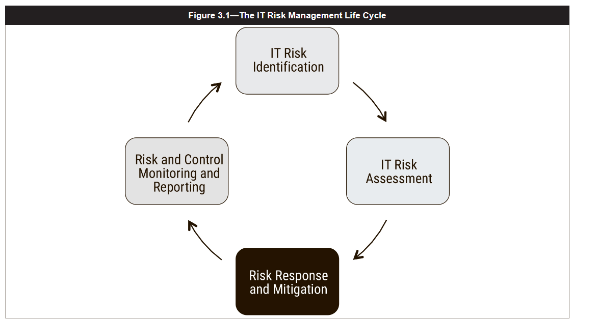

Slide 5
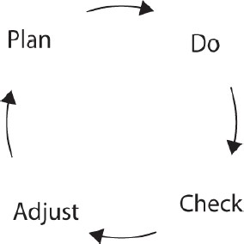
Risk Response
It’s a good idea to think about this risk response action plan in a Plan-Do- Check-Adjust (PDCA) life cycle
Plan-Do-Check-Adjust cycle

Slide 6
Risk and Control Ownership
  Every risk identified in the risk register should have a specified owner at a management level.
  This owner should be empowered to make decisions on behalf of the enterprise.
  In general, the risk owner should be a senior executive or manager responsible for one or more of the business processes or functions that may be impacted ( for example: the HR Manager will be the Risk owner for the risk at the HR Department level)
  The risk practitioner should communicate with risk owners to ensure that they are aware of what risk responses have already been implemented and responses that are pending implementation.

Slide 7
Ownership and Accountability
  The purpose of determining risk ownership is to ensure accountability is in place.
  A risk owner must be someone with the budget, authority and mandate to select an appropriate risk response based on analyses and guidance provided by the risk practitioner.
  If someone who lacks one or more of these is chosen as the risk owner, that person will be incapable of exercising the full scope of ownership responsibilities, and true accountability cannot be expected.
  Similarly, a control should be owned by the owner of the risk that it mitigates.
  However, the control may be owned by someone else in the case of controls that affect more than one risk, Risk and control owners should be recorded in the risk register.
  In general, risk owners need to actively lead the risk management activities performed by risk practitioners and to ensure the desired outcomes can be clearly understood by risk practitioners.
  Accountability extends beyond the basic risk response decision to approving specific controls when mitigation is the chosen risk response.

Slide 8
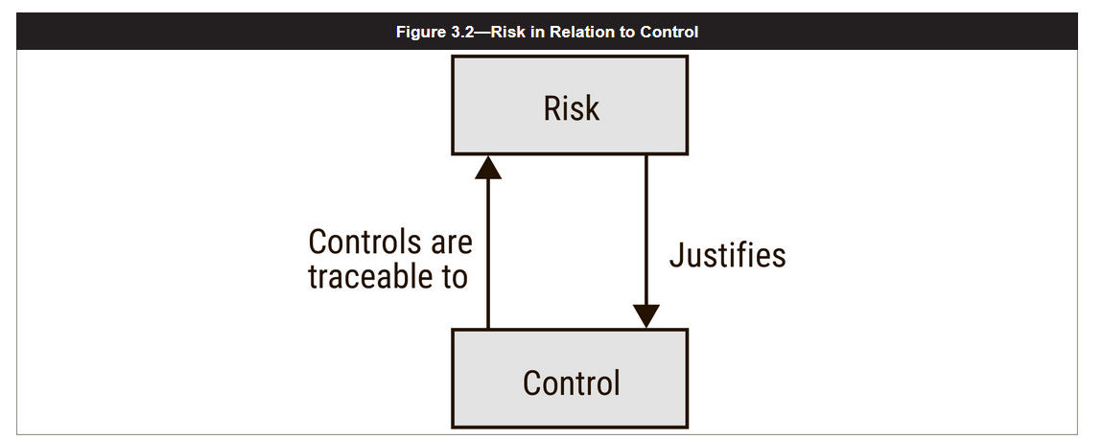
the concept is to create a direct link between risk and control, so that all risk is addressed through appropriate controls and all controls are justified by the risk that mandates their existence.
This relationship is shown in figure 3.2.

Slide 9
Risk Treatment/Risk Response Options
  The goal of risk response is to bring risk into alignment with the organizational risk appetite and tolerance.
  Factors such as on-staff expertise, strategic direction, legal and regulatory requirements and organizational culture should be considered when considering precisely what responses are best suited to particular areas of risk.

Slide 10
Aligning Risk Response with Business Objectives
  The risk assessment report and risk register will document the risk identified during the identification and assessment phases of the risk- management process.
  Both the report and the register should indicate the priority of each risk.
  Risk practitioners should keep in mind that these recommendations are guidelines.
  Management is responsible for evaluating and responding to the recommendations included in the report, first by determining the best response and then developing an action plan and implementation strategy that addresses the risk in a manner consistent with the risk appetite and risk tolerance of the enterprise.
  The role of the risk practitioner is not to decide on behalf of the organization. Instead, the risk practitioner role is to ensure that management has the best available information to make informed decisions.

Slide 11
3.2.2 Risk Response Options
  Evaluation of an appropriate risk response is part of the risk-management process cycle, not a one-time activity.
  There are four commonly accepted options for risk response:
      Risk acceptance
      Risk mitigation
      Risk sharing/transfer
      Risk avoidance
  Keep in mind that the purpose of defining a risk response is to bring risk in line with the enterprise defined risk appetite and tolerance as cost-effectively as possible, not to eliminate or minimize the risk at all costs.
  Finding the right balance is a management function that considers all of the constraints such as budget, time and resources.

Slide 12
Risk Acceptance
  The choice to accept risk is a conscious decision made by senior management. Risk acceptance means recognizing both the existence of risk and its potential impact, then deciding with full awareness to allow (assume) the risk to remain without (further) action.
  Management is always accountable for the impact of a risk event should it occur, so the decision to accept a risk is made according to the organizational risk appetite and risk tolerance.
  Because the goal of risk management is to bring risk within acceptable levels as cost-effectively as possible, risk that falls within the organizational risk appetite without any action being taken generally should be accepted.
  Management may also choose to accept a risk outside of the risk appetite but within the range of the organization risk tolerance.
  Examples of risk acceptance as a result of risk tolerance include:
    Projections indicate that a certain project will not deliver the required business functionality by the planned delivery date, but management decides to proceed with the project hoping that the delivery will come soon after the planned date.
    A particular risk would have catastrophic consequences but is assessed to be extremely rare, and approaches to reduce it are cost prohibitive. Management may decide to accept this risk.

Slide 13
  Enterprises should also recognize that other approaches to risk management typically yield residual risk that must be acceptable to the organization.
  A mitigated risk, for instance, is typically still non-zero and must be evaluated to ensure that it falls within the organizational risk appetite.
  Additionally, risk acceptance is not a one-time process.
  The level of risk and potential impact of an incident can change dramatically as assets increase or decrease in value, new threats emerge, attackers gain additional skills or motivation, vulnerabilities are discovered, the existing controls become weaker or the operations team becomes less diligent.
  Enterprises should conduct regular reviews of their accepted risk to ensure that these continue to be consistent with senior management's levels of risk appetite and risk tolerance.
  Wherever a risk owner is unwilling to accept the current risk, a new risk response is necessary.
  This process is continued through iterations until the risk reaches an acceptable level, at which point the risk owner should formally accept the risk.

Slide 14
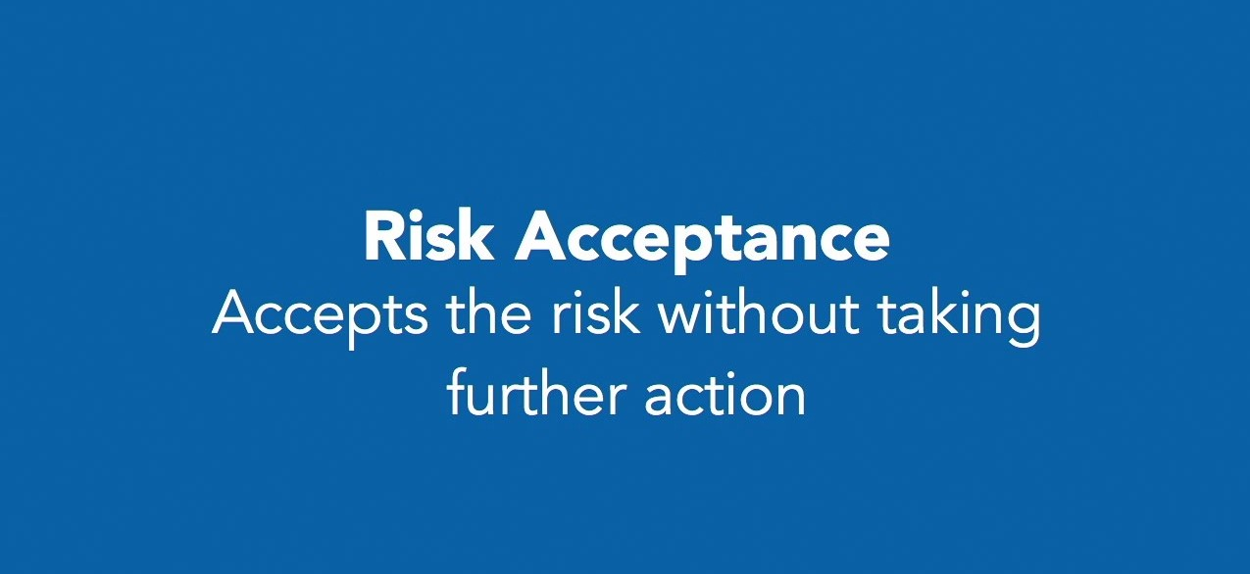

Slide 15


Slide 16
Risk Mitigation
Risk mitigation refers to actions that the enterprise takes to reduce a risk.
Some examples of risk mitigation are:
  maturing internal processes
  Installing a new access control system
  Improving organizational policies or operational procedures
  Developing effective plans for incident response, disaster recovery or business continuity
  Using compensating controls to address areas of persistent weakness in production systems
Mitigation is typically achieved through the implementation of controls, which affect the frequency and/or impact of the risk.
multiple controls may be needed to reduce risk to an acceptable level. Risk practitioners should also take care to account for the cost of controls relative to their effects on risk.
Controls whose implementation cost exceeds the risk that they are meant to mitigate are cost-ineffective and should not be deployed without further justification.
Keep in mind also that the goal of mitigation is to reduce risk to an acceptable level, not to eliminate risk entirely.
Once mitigation is complete, acceptance of residual risk should be documented and subject to periodic reevaluation in the same manner as the acceptance of inherent risk.

Slide 17
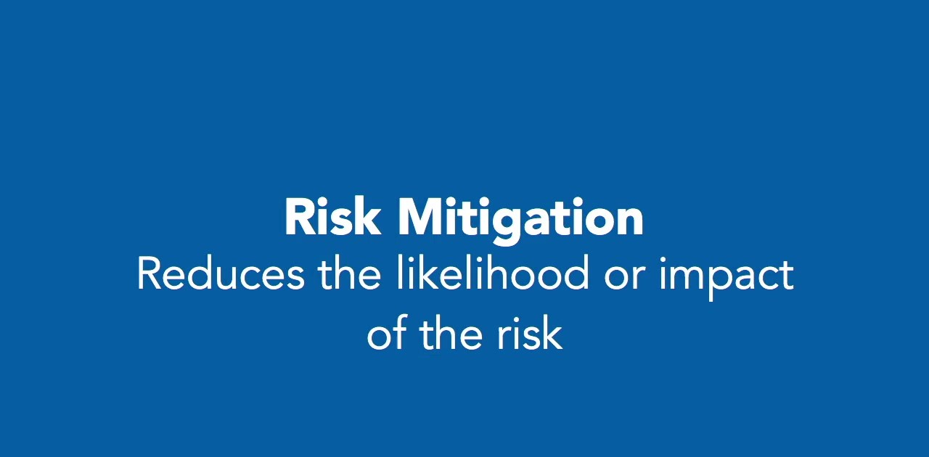

Slide 18
Examples of Controls
Managerial
Requiring an acceptable use policy to dictate IT usage within the organization
Starting a risk management program to identify, lower, and monitor unacceptable risk levels within the organization
Technical
Implementing additional firewalls to protect internal (non-public facing) systems
Adding 802.1X port-based network access control to deter unapproved assets being added to the network
Installing an intrusion detection system/intrusion prevention system (IDS/IPS) to monitor for malicious activities or violations of policy
Operational
Implementing delegation/separation of duties procedures to assure that one person does not have the sole control over key duties
Mandating security training and certification requirements to increase the baseline knowledge of IT security-related issues and concepts
Preparedness
Executing a tabletop exercise of the Continuity of Operations Plan to test its effectiveness and identify gaps that should be addressed

Slide 19
Risk Transfer/Sharing
  The most common example of risk transfer is the purchasing of third-party insurance, which provides a guarantee of compensation or replacement should a loss occur.
  Partnerships and outsourcing agreements are also forms of risk transfer, in which two or more organizations work together under an arrangement in which both risk of loss and potential for profit are divided among the participants
  Transferred risk, like all other risk, should be reviewed on a regular basis to ensure that it remains appropriate and adequate.
  For example, an enterprise should ensure that the current amount of insurance is adequate to cover losses and that the enterprise is compliant with the terms and conditions of the coverage.
  With regards to outsourcing arrangements, effective management includes regular reviews of security compliance reports or operational procedures to ensure that the outsourced services are being done according to contractual agreements.

Slide 20
Risk Sharing
Risk sharing can involve:
  Outsourcing of some activities to a third party to reduce the financial impacts of a risk event in many cases.
  Sharing off-site (co-location) assets and contractual obligations with other entities is one way that organizations implement risk sharing; a cloud service provider can be used within this scenario.
  Cloud provider might be contractually obligated to assume part of the financial impact in the event of a breach.
  Use of an insurance service to cover the financial impacts (at least partially) of
a breach.

Slide 21
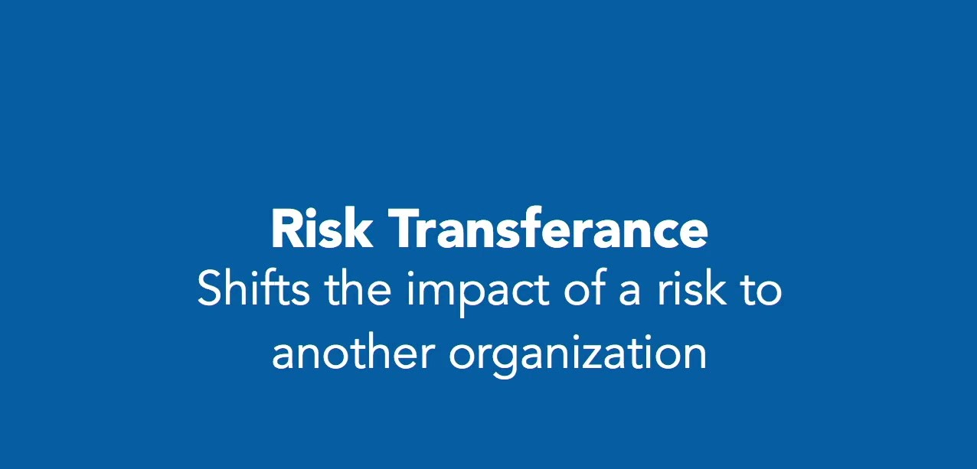

Slide 22
Risk Avoidance
Risk avoidance is the choice that remains when no other response is adequate, meaning the following are true:
  The current exposure level is consider unacceptable by management.
  Mitigation or transfer that would bring the risk in line with acceptable levels would cost more than the benefits that the enterprise derives from the activities.
  Risk avoidance is the option taken when, after controls have been considered, the level of risk is still not acceptable.
Some examples of risk avoidance include:
  Relocating a data center away from a region with significant natural hazards
  Evacuating staff from a work area in which there is substantial civil unrest or threat of war
  Declining a project whose business case shows a substantial likelihood of failure
  Rejecting a partnership agreement in which potential losses are allocated to the enterprise.
  Deciding not to use proprietary technology or software from a vendor because it has only recently begun operations or faces uncertain future prospects

Slide 23
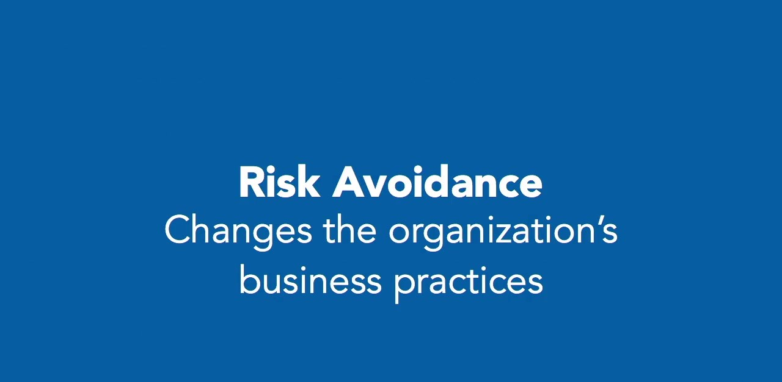

Slide 24


Slide 25
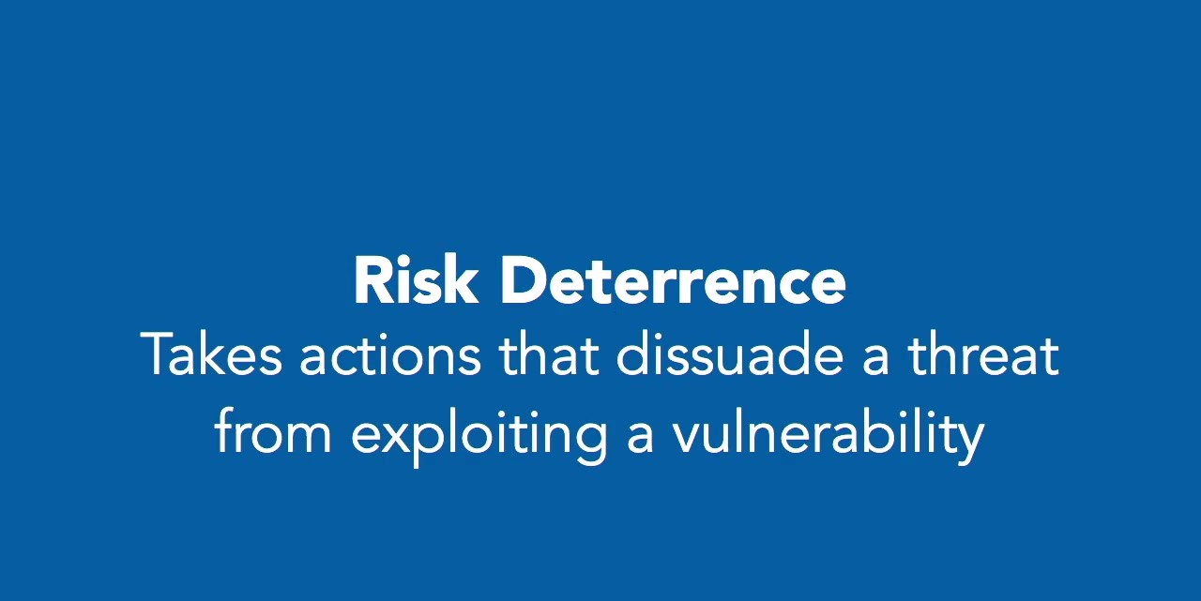

Slide 26


Slide 27
Choosing a Risk Response
In some cases, the decision to pursue a particular risk response may not be immediately obvious.
In such cases, the best risk response is typically determined based on analysis which will consider server factors including:
    Priority of the risk as indicated in the risk assessment report
    Complexity of recommended controls in cases involving mitigation
    Alternatives that are suggested through further analysis
    Cost of the various response options, including:
        = Acquisition cost
        = Training cost
        = Impact of productivity
        = Maintenance and licensing costs
    Management decision based on:
        = Financial objectives
        = Tolerance and variability of loss
        = Relative importance
        = Risk tolerance and risk appetite
    Requirements for compliance with regulations or legislation
    Alignment of the response option with organizational strategy
    Possibility of integrating the response with other initiatives
    Organizational culture
    Time, resources and budget available for the response
    Environmental and market conditions and evolution

Slide 28
Risk Response Parameters
Cost is not only the financial impacts of any decision but also other aspects such as: loss of goodwill, loss of brand status, Consider the cost to maintain the responsive mitigation over its required life span.
Ability (capability) for the organization to implement the response should also be considered.
Effectiveness: the extent to which the response reduces the likelihood or the impact of the risk event to the organization
Efficiency: the ability for a risk response to cover one or more objectives that our organization sets in front of them.

Slide 29
The selection of the appropriate response is often based primarily on the value obtained for the cost.
Specific responses to risk are typically recommended in business cases, which document the problems and one or more options as well as providing detailed analyses on which management may base decisions.
Beyond being common and useful tools for decision support, business cases also serve as operational tools against which to evaluate and support investments throughout their life cycles.
The risk practitioner may find it helpful to conduct a cost-benefit analysis for each alternative to estimate its likely value to the organization relative to the immediate expense.
Another option is to calculate return on investment (ROI), which can make it easier to see how much time would pass before the enterprise would recoup the cost through savings or increased revenue.
Risk responses should be documented in the risk register with clear accountability and time frames for completion.
Many risk responses cannot be implemented instantly, and a plan of action and milestones (POA&M) can be useful as a means of identifying a basis for tracking progress and setting times of review up the point of completion.
Risk practitioners should ensure that these reviews are completed and that planned mitigations are not superseded or abandoned to competing priorities.

Slide 30
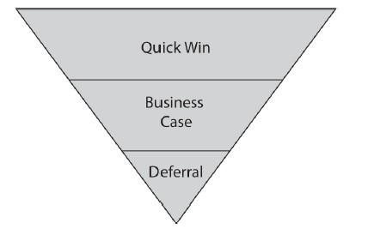
Prioritizing Risk Responses
There are three prioritization options that you need to be aware of:
Quick Wins: Quick wins are actions that can be taken that really are winners, for which you are looking to select risk responses that are high reward and low cost and that are both effective and efficient.
Business Cases: for a particular risk response must be made if the response can’t be quickly or easily implemented without a significant cost or change to the organization or the system
Deferrals (delay): is the choice when you have a high cost of response associated with a low risk, one where even a business case can’t be made

Slide 31
Risk Response Action Plans
Risk Response Action Plan lists the risk responses that have been chosen and charts their progress and associated timeline, with an appropriate action owner.
Risk response action plans can contain any number of data points inside of them, but at a minimum, they should list
  The prioritized risk responses, their associated costs, a timeline for their
implementation, the associated cost, and the owner of the risk response.
The plan should be formally accepted by senior leadership, monitored continuously, and reviewed regularly to ensure it does not deviate from a risk or response perspective.

Slide 32
Third-party Risk Management
  Not all risk arises from within an enterprise.
  Outsourcing is a form of risk transfer, but reliance on a third-party provider also creates exposure.
  The risk practitioner should take care to address risk that arises when an organization outsources business functions, supportive services, IT services and data management.
  Typically, ownership of data and business processes remains with the outsourcing enterprise, not the contracted service provider.
  This relationship can create legal liability that may be difficult for the outsourcing enterprise to manage, because outsourcing by its very nature places most of the day-to-day operations, staff and procedures within the scope of the contract outside of the enterprise direct control.
  The risk can be mitigated to a certain extent by the inclusion of carefully worded that require the vendor to repay the losses suffered due to legal/regulatory violations on the service-provider side.
  The relationship between an outsourcing provider and the enterprise is defined by a contract.
  Legal requirements written into contracts should address the jurisdiction for any complaints or disagreements with the provider, and regulations in the host country regarding disclosure to law

Slide 33
Concerns that should be considered in relation to the risk of using an outsourced supplier include:
  Hiring and training practices of the supplier
  Reporting and correlation between the outsourcing enterprise and supplier
  Time to notify and respond to any incidents
  Liability for noncompliance with terms of the contract
  Nondisclosure of data or business practices
  Responding to requests from law enforcement
  Length of contract and terms for dissolution/termination of contract
The risk practitioner should take steps to ensure any provider of outsourced services used by the enterprise is compliant with the organization’s defined requirements or at a minimum generally accepted good practices .
The risk practitioner should understand the variety of cloud computing models and capabilities which the organization may desire to pursue.

Slide 34
Issue, Finding and Exception Management
  Variation from the norm or desired outcome represents uncertainty and is therefore a source of risk.
    issue management is the process by which organizations manage problems, or issues. That is, how they identify the issues and respond appropriately.
        examples are:
        Poor quality products such as malfunctioning software
        Team members who lack skills and knowledge
        Projects or activities for which there is no budget
        Disturbed communication such as language barriers or lack of communication in the group
        Delivery problems
    The first step in successful issue management is to determine what the problem is. There can be multiple factors involved, such as employee concerns, communication breakdowns, improper tools, or technical difficulties. Defining the problem first helps you create a plan to resolve it promptly and efficiently.
  Enterprises can manage this risk by applying strong procedures to areas of variation, including formal approaches to configuration, release, exception, issue and change using configuration management, release management, exception Management , issue Management and change management
  In most cases, responses will involve changes, which should go through the change management process
  Addressed issues and findings should then be monitored to ensure that the timely actions produced the anticipated results and identify any new issues that may arise as a result of the changes made.

Slide 35
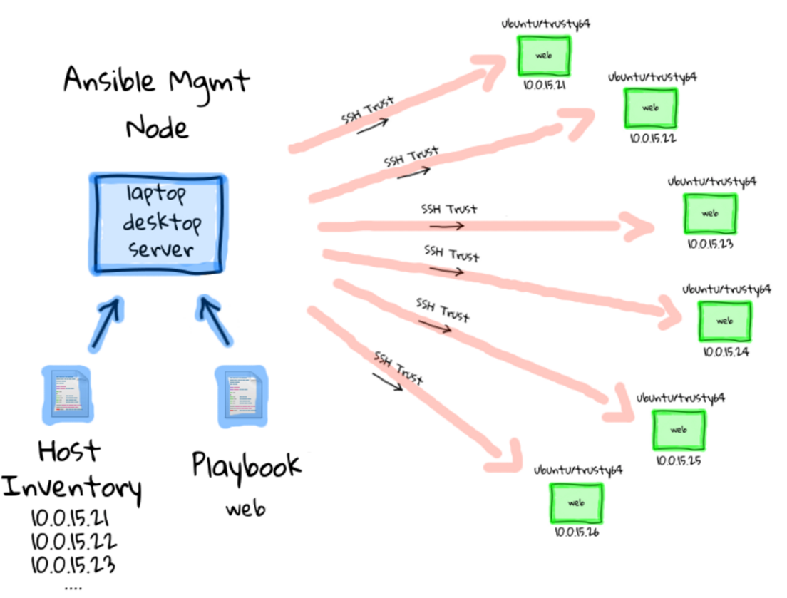
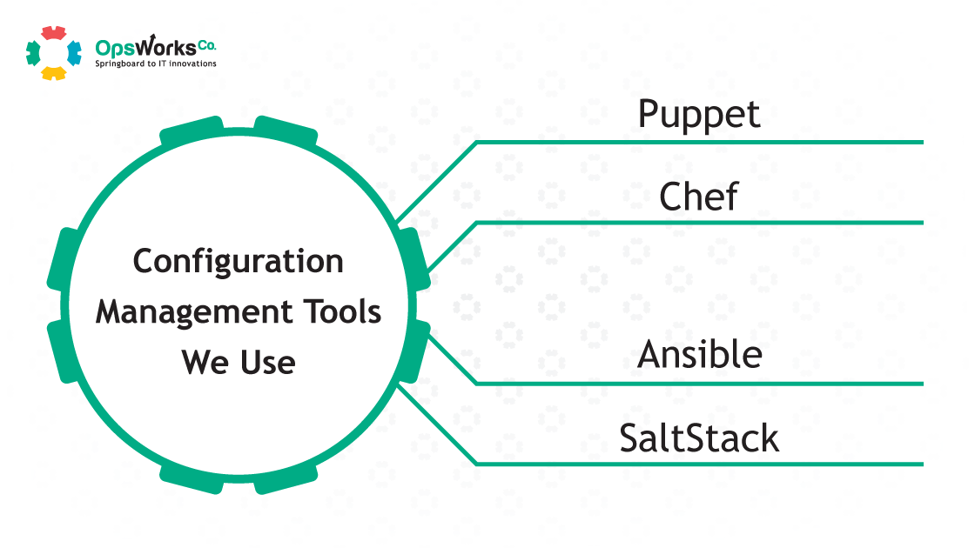
Configuration Management
  Technical complexity and leading-edge technology use can be a key cause of information risk and scales with the size of an enterprise.
  Standardizing system configurations can greatly reduce this complexity by simplifying planning, testing, implementation and maintenance activities.
  The risk practitioner should first determine whether standard configurations have been established and approved and then verify their proper documentation.

Slide 36
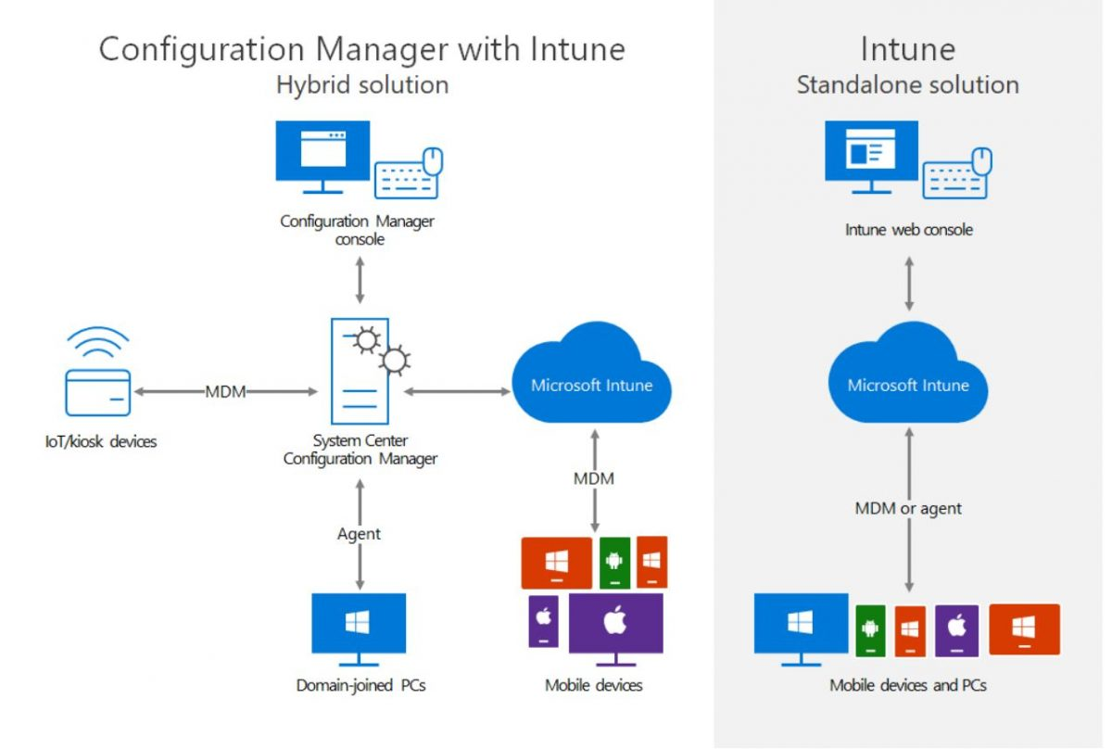

Slide 37
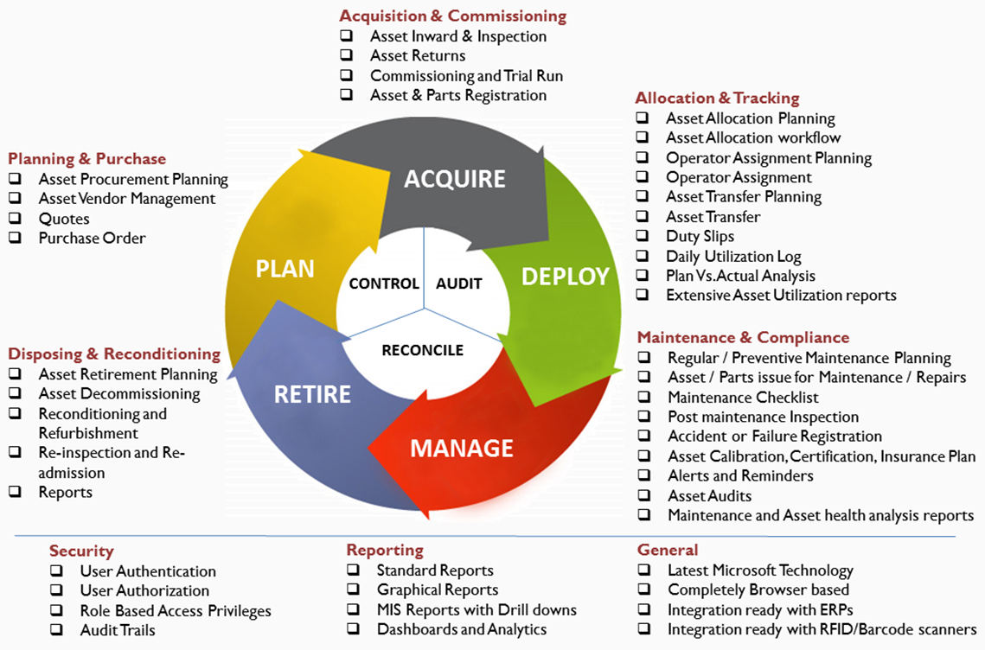
Benefits of a good IT asset life cycle management solution:
  Risk management has become an integral part of good asset management practice
  ITAM helps IT teams identify the assets and the threats they face.
  ITAM helps the IT team to manage the risks associated with threats
  Improve the quality of IT services
  Know the total cost of ownership of an asset
  The aging of assets is one of the main risks in the industry.
What to include in your asset inventory:
Hardware – e.g. laptops, servers, printers, but also mobile phones or USB memory sticks.
Software – not only the purchased software but developed software and freeware.
Information – not only in electronic media (databases, files in PDF, Word, Excel, and other formats) but also in paper and other forms.
Infrastructure – e.g. offices, electricity, air conditioning – because those assets can cause a lack of availability of information.
People are also considered assets because they also have lots of information in their heads, which is very often not available in other forms.
Outsourced services – e.g. IT services, legal services and also cloud-based services like Microsoft Office
IT asset life cycle management solution:

Slide 38
Exception Management
Policies and procedures exist to standardize decisions and behavior.
However, enterprises may encounter circumstances where usual practices are unsuitable due to timely technical or administrative constraints.
Any exception should be formally documented and approved by a senior manager or executive before it is acted upon.
Every exception represents deviation from standards, and introduces complexity, which can create or obscure risk, Therefore, exceptions should be reviewed at least annually to ensure that they are still necessary, and any unnecessary exceptions should be removed.

Slide 39
Change Management
Requests to change systems or configurations should be subject to formal review and approval by a dedicated committee.
Change tends to alter the risk profile of an enterprise, so effective risk management calls for change advisory boards (CABs) comprised of representatives from several business departments and responsible for overseeing all information systems operations and approving changes to those systems.
Under an effective change control model, changes are submitted for review by the CAB, which verifies that:
  The change request does not unknowingly affect risk or security.
  The change is formally requested, clearly justified, approved and documented.
  The change is scheduled at a time convenient for the business and IT.
  All stakeholders affected by the change are advised of the change.
  The change request includes test, implementation and rollback plans.
  The change will not compromise the enterprise's security baselines.
The intention of this model is to provide a balance between allowing needed changes to occur and preserving system reliability and stability.

Slide 40
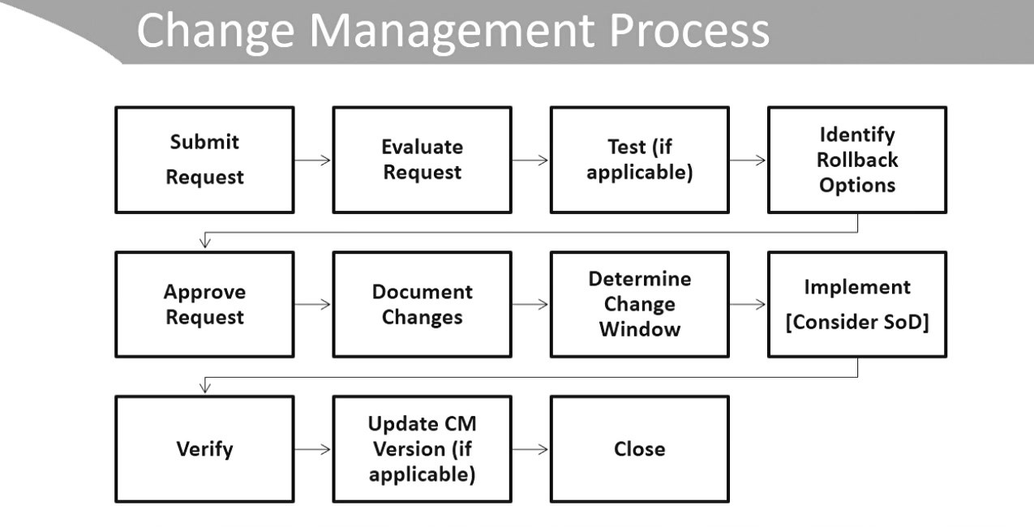

Slide 41
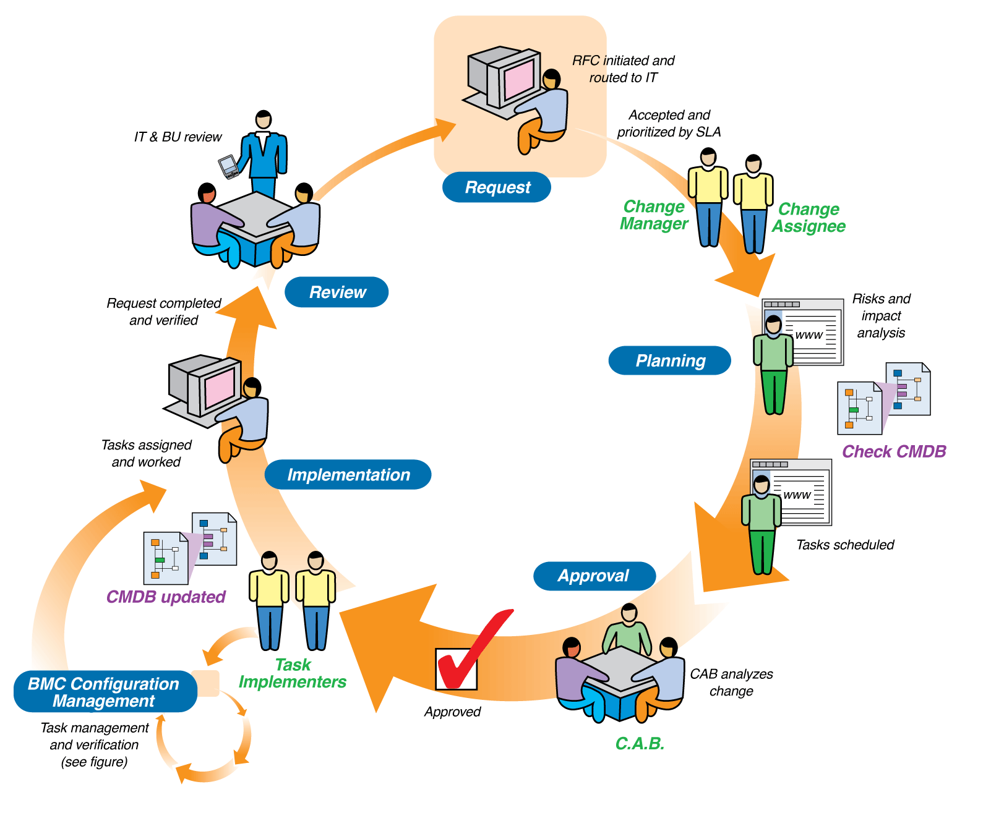
Lifecycle of a
change request

Slide 42
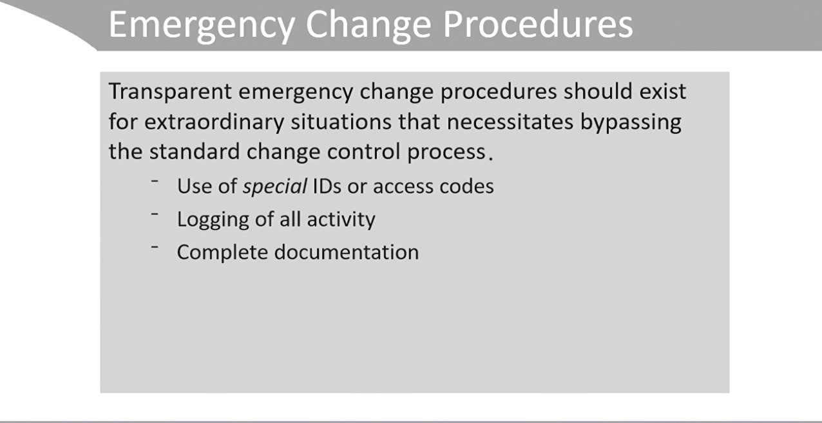

Slide 43
Management of Emerging Risk
  Risk is fundamentally dynamic because it arises from uncertainty.
  Even the most well-developed risk management program must operate on a continuous basis to be effective, because new areas of risk are always emerging.
  The deployment of new controls and introduction of new technologies both have the potential to contribute to emerging risk.
Vulnerabilities Associated with New Controls
  Any changes that deal with controls should be carefully considered. This includes both the addition of new controls and modification of existing controls.
  Beyond their intended benefit to the enterprise, new or updated controls may also introduce new vulnerabilities.
  For example , an access control system that protects against unauthorized access may inadvertently deny access to legitimate users resulting in calls for technical assistance, delays in processing and user frustration.
  Modified controls may also not perform as expected, potentially reducing their effectiveness.
  Enterprises should coordinate with stakeholders on a proactive basis and perform rigorous user acceptance testing (UAT) under conditions as close to real-world use as possible prior to full implementation of any additions or changes to the control baseline.

Slide 44
Impact of Emerging Technologies on Design and Implementation of Controls
  Many enterprises take a proactive approach to the adoption and use of new technologies in an attempt to gain or maintain competitive advantage.
  Managing risk in a highly dynamic environment requires the risk practitioner to be alert to the development of new technologies and proactive in assessing the risk of their incorporation into the enterprise.
  The risk practitioner may find it beneficial to use automated network scanners and other tools to detect unauthorized implementations of new devices or technologies that have not yet been reviewed and approved for use.
  Staff also should be made aware of the processes required to submit a new technology for consideration, and any exceptions to full evaluation should be documented and approved by management.
  Emerging technologies can have significant effects on the design and implementation of controls, sometimes beneficial and other times detrimental.
  Controls need to be designed and implemented in ways that are suited to addressing the threats, vulnerabilities, and impacts of this dynamic environment.

